Slide 1
Kindergarten Program
2019

Slide 2
“Hello, There!”
Focus:
Singing on cue
Echo
Familiar class opening
Dynamics (louds and softs)

Slide 3
“Clap, Wiggle, Stomp”
Focus:
Steady beat
Reacting to verbal cues
Gross motor skills
Moving (non-locomotor skills) to the beat
Sequence:
Clap your hands
Tap your toes ( touch your nose)
Hop on one foot
Wiggle around
Slap your knees
Stamp your feet

Slide 4
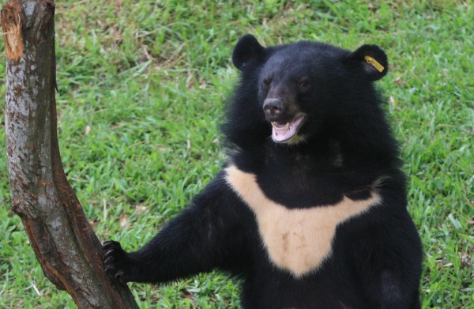
Kuma San (Little Bear)
Mawa re me gee
Ryo te wo tsui te
Kata ashi agate
sayonara
Turn yourself around
Now please touch the ground
Hop with just one paw
Goodbye!

Slide 5
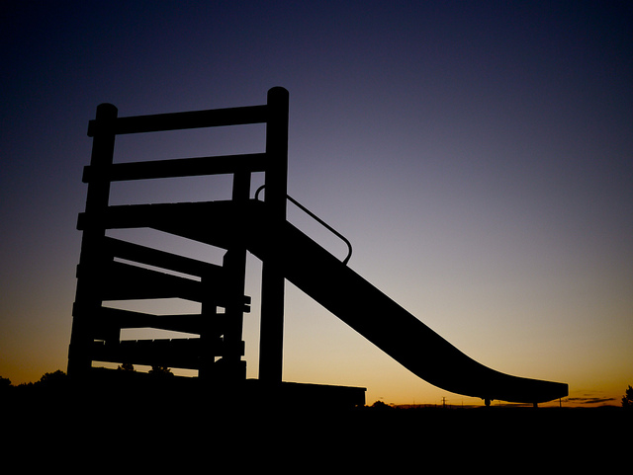
“Here I Go!”
Focus on:
Pitch direction
Melody
Aural-kinesthetic movement
Singing
Steady beat

Slide 6
Andy Pandy
Working with opposites: Down, Up, In, Out

Slide 7
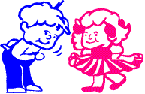
“Skip to My Lou”
Focus:
Steady beat
Reacting to verbal cues
Gross motor skills
Moving (locomotor skills) to the beat
Opposites (standing opposite from each others
Left and right

Slide 8
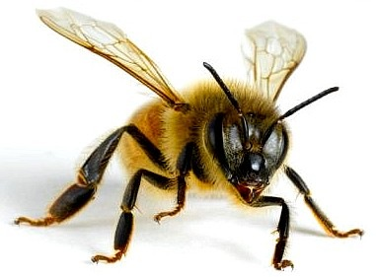
“Shuga Bee”
Focus on:
Science of bees
Moving on the beat
Non-locomotor movement
Singing

Slide 9
Busy Buzzy Bee
Following melody direction:
High and low

Slide 10
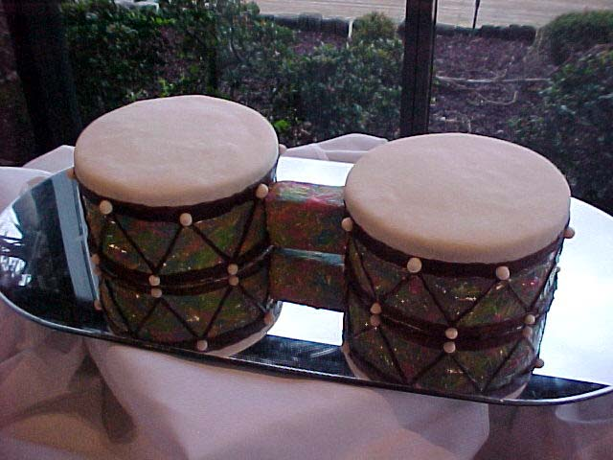
Bonga
Children around the world play copycat games like our “Simon Says”
Call and Response
Learning to move in a meter of 3

Slide 11
The Bus
Focus on:
Travel
Machine sounds
Movements to a steady beat
Opposites
Memorizing sequences:
People…
Wheels…
Horn…
Money…
Wipers…
Driver…

Slide 12
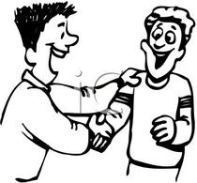
“Rig-a-Jig Jig”
Focus on:
Responding to verbal cues
Singing
Moving to the beat
Compound meter
Social greetings (handshakes)

Slide 13
Ikhanda Maslombe
Zulu Language version
English version
“My Head and my Shoulders,
My chest and my middle.
My knees and then my toes, oh,
My knees and then my toes”
“Ikhanda, maslombe,
Si fuba na khalo.
Ma dolo na ma zwani, oh,
Ma dolo na ma zwani”

Slide 14
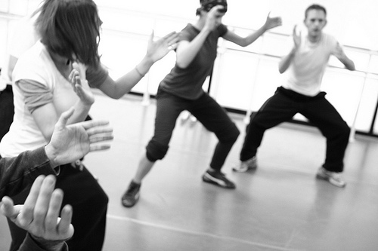
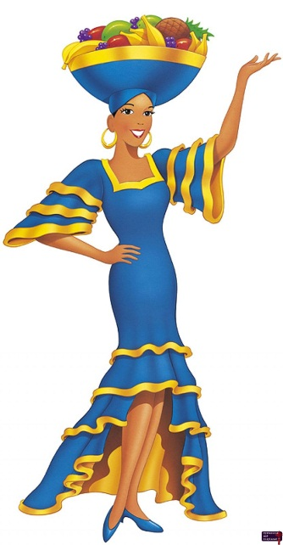
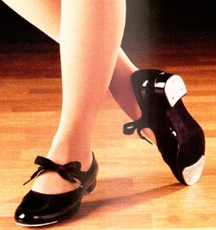
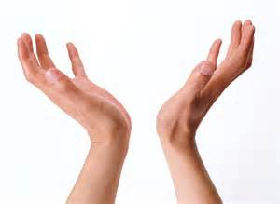
“Mi Cuerpo Hace Musica” (“There’s Music In Me”)
Focus on:
Body percussion
Steady beat
Singing
Language (foreign and english)

Slide 15
Bam Chi Chi Bam

Slide 16
Polly Polly Wee
With lyrics
Without lyrics:

Slide 17
Goodbye Kindergarten!

