Slide 1
UPK Program
Pine Velley
Elementary School
Mr. Daly Griffen
Mrs. Lindquist
Mrs. Clapp
Mrs. Smallback
Mr. Huestis
2019

Slide 2
“Hello There!”
Focus:
Familiar opening activity
Singing together
Singing a melody
Singing a song with
Contrasting dynamics
(louds and softs)

Slide 3
“Head, Shoulders, Knees and Toes”
Focus:
Singing together
Steady beat
Body kinesthetics
Moving while singing
Following verbal and non-verbal cues
Language development

Slide 4
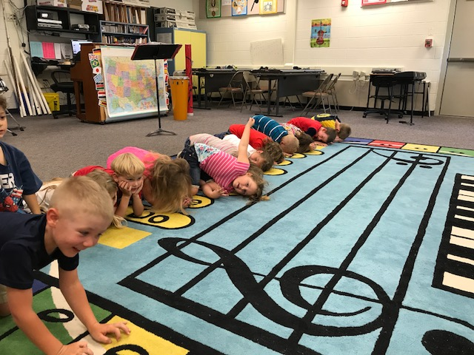
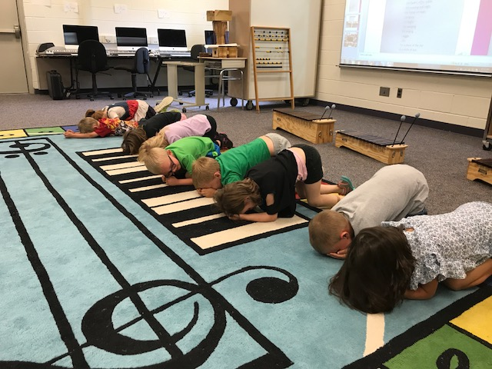
“Hi Dee Roon”
Focus:
Singing together
Steady beat
Body Kinesthetics
Moving while singing

Slide 5
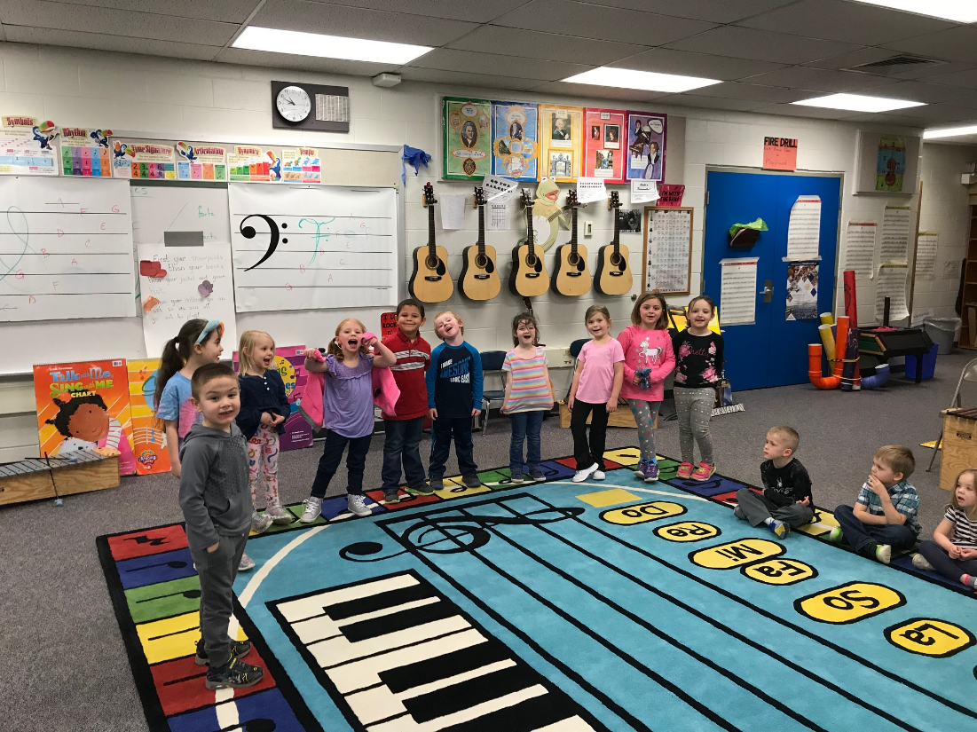
Juba/O Ma Washi
Focus:
Game songs
Following movement cues
Steady beat
Body Kinesthetics
Moving while singing

Slide 6
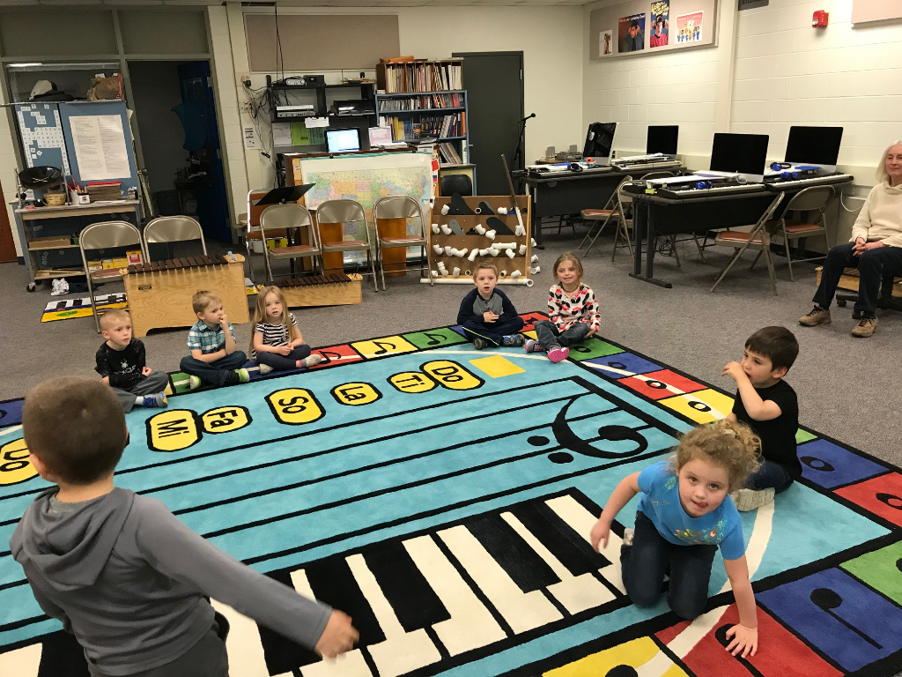
I’m Tall, I’m Small
Opposites:
Concept of high and low
Large and small
Allowing student ownership, decision-making

Slide 7
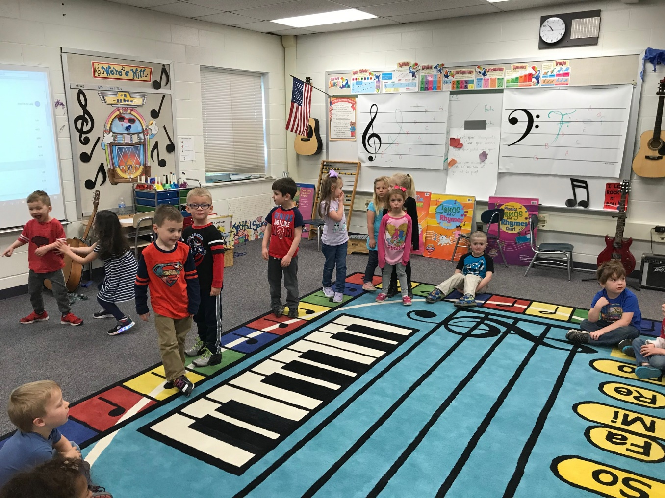
She’ll Be Coming round the Mountain

Slide 8
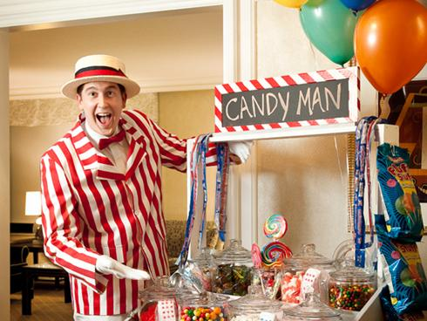
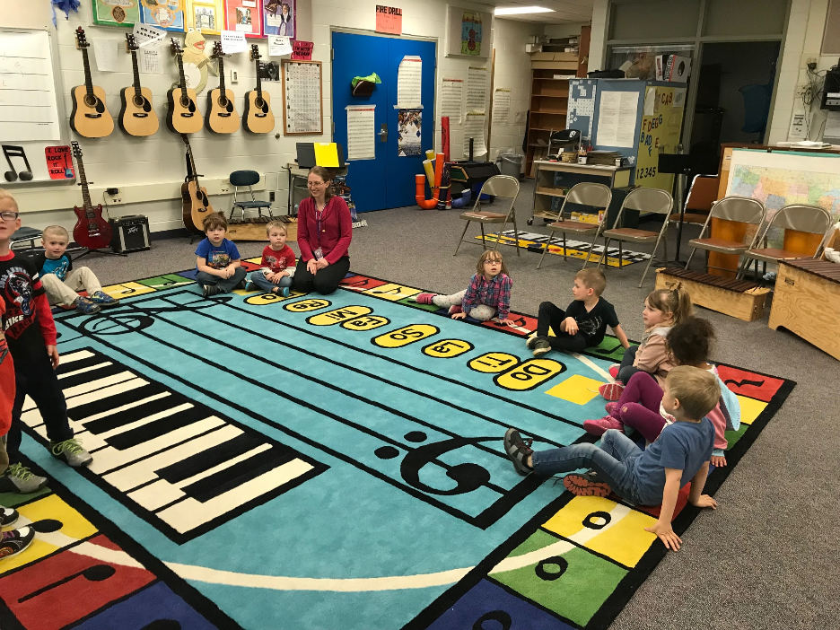
Candy Man, Salty Dog

Slide 9
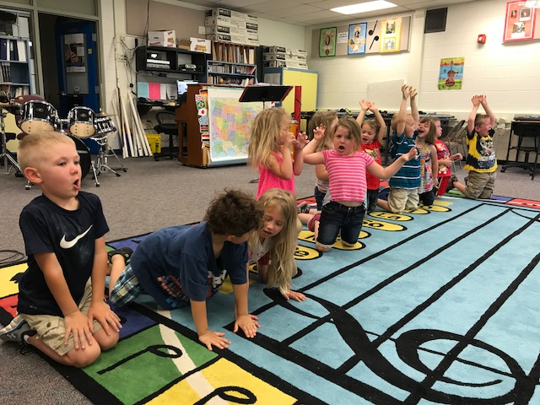
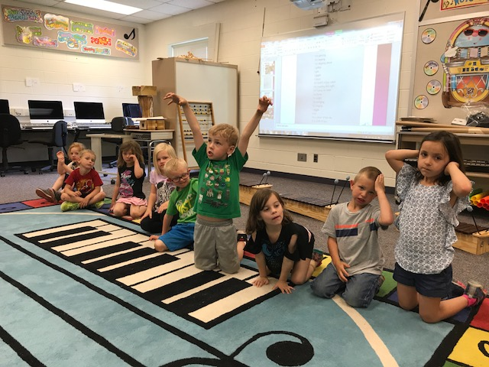
“Grizzly Bear”
Focus:
Dynamic contrast
Voice choice (whisper, shout)
Steady beat
Imitation
Math Skills

Slide 10
“Doing the Penguin”
Focus:
Following recorded instructions
Steady beat
Body Kinesthetics
Sequential Movement

Slide 11
“Goodbye Song”
Clapping on the beat
Following verbal cues
Familiar closing activity

Slide 12
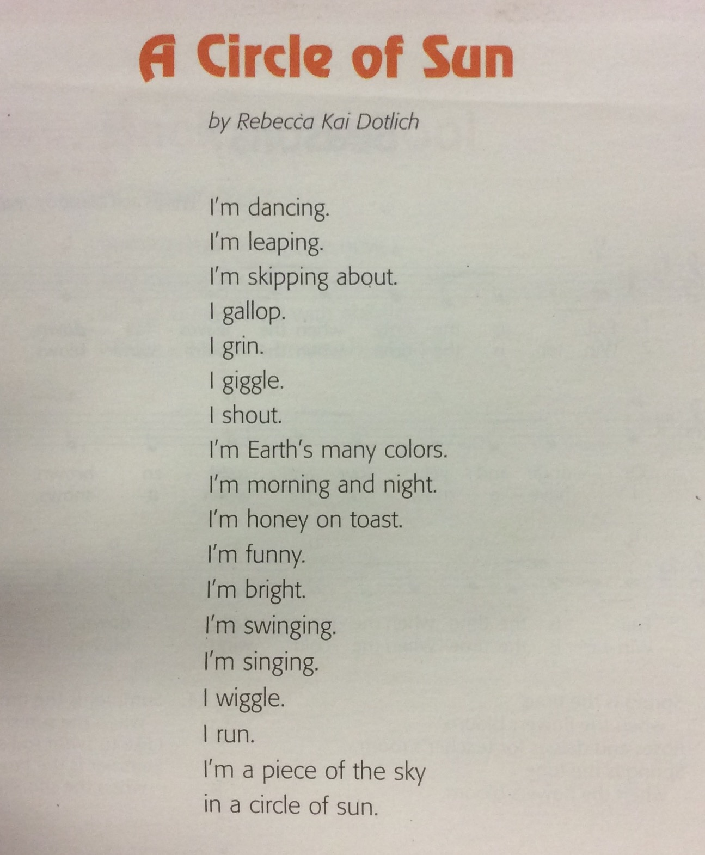

Slide 13
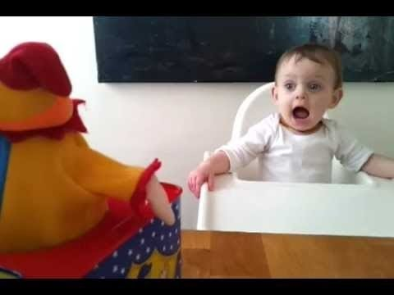
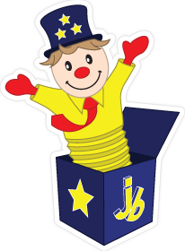
“Jack-in-the-Box”
Focus:
Singing together
Steady beat
Body Kinesthetics
Moving while singing

Slide 14
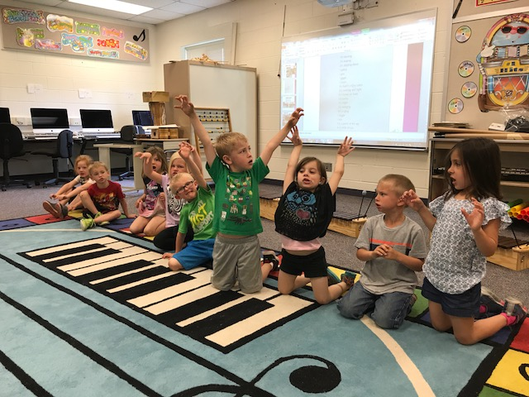
Copy Cat
Copy Cat
Focus:
Following movement cues
Steady beat
Body Kinesthetics
Moving while singing

Slide 15
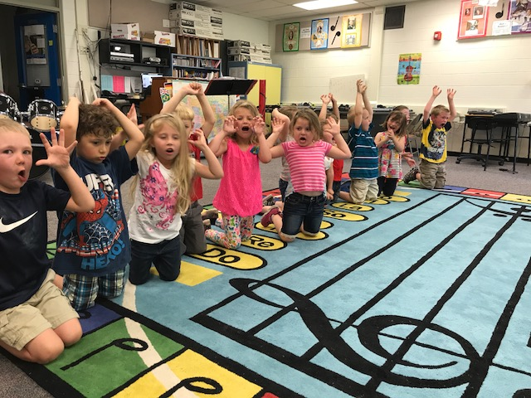
“A Sailor Went to Sea”
Focus:
Memorizing sequence of events
Non-locomotor movements
Ordering movements

